Slide 1
بسم الله الرحمن الرحیم
Notes:
Introduce yourself
ان شاء الله که وخت خوب و پربرکت خواهیم داشت

Slide 2
CS101 Introduction to Computer Science

Slide 3
Lecture 13

Slide 4
hexadecimal

Slide 5
0 1 2 3 4 5 6 7 8 9 a b c d e f

Slide 6
base-16

Slide 7
16
1
FF

Slide 8
16
1
FF
16 × F
+
1 × F

Slide 9
16
1
FF
16 × 15
+
1 × 15

Slide 10
16
1
FF
240
+
15

Slide 11
16
1
FF
255
Notes:
So why is hex popular?

Slide 12
pointers
Notes:
A pointer is essentially an address, or more precisely a variable that can store an address.

Slide 13
int n = 50;
int *p = &n;
Notes:
addresses{2,3}.c

Slide 14
string

Slide 15
string s = "HI!";

Slide 16
s
 |  |  | H 0x123 | I 0x124 | ! 0x125 | \0 0x126 | 0x127
Notes:
But who cares about the specific addresses, think of this just as a pointer literally, an arrow.

Slide 17
string s = "HI!";
Notes:
addresses6.c

Slide 18
typedef char * string;

Slide 19
typedef uint8_t BYTE;

Slide 20
typedef uint8_t BYTE;

Slide 21
typedef uint8_t BYTE;

Slide 22
typedef char *string;

Slide 23
typedef char *string;

Slide 24
typedef char *string;

Slide 25
pointer arithmetic
Notes:
addresses{8,9,10}.c
Were these ints instead of chars, you would still do +1, and the compiler would know that it's really +4.

Slide 26
strcmp
Notes:
compare{1,2}.c
Have to type "HI!"

Slide 28
s

Slide 29
s
 |  | H | I | ! | \0

Slide 30
s
 |  | H 0x123 | I 0x124 | ! 0x125 | \0 0x126

Slide 31
0x123 s
 |  | H 0x123 | I 0x124 | ! 0x125 | \0 0x126

Slide 32
0x123 s |  |  |  |  |  |  |  | t
 |  | H 0x123 | I 0x124 | ! 0x125 | \0 0x126

Slide 33
0x123 s |  |  |  |  |  |  |  | t
 |  | H 0x123 | I 0x124 | ! 0x125 | \0 0x126 |  |  |  |  | H | I | ! | \0

Slide 34
0x123 s |  |  |  |  |  |  |  | t
 |  | H 0x123 | I 0x124 | ! 0x125 | \0 0x126 |  |  |  |  | H 0x456 | I 0x457 | ! 0x458 | \0 0x459

Slide 35
0x123 s |  |  |  |  |  |  |  | 0x456 t
 |  | H 0x123 | I 0x124 | ! 0x125 | \0 0x126 |  |  |  |  | H 0x456 | I 0x457 | ! 0x458 | \0 0x459

Slide 36
s |  |  |  |  |  |  |  | t
 |  | H 0x123 | I 0x124 | ! 0x125 | \0 0x126 |  |  |  |  | H 0x456 | I 0x457 | ! 0x458 | \0 0x459
Notes:
compare{3,4}.c

Slide 37
Notes:
copy{0,1}.c
Have to use "hi!" in lowercase

Slide 38
s

Slide 39
s
 |  | h | i | ! | \0

Slide 40
s
 |  | h 0x123 | i 0x124 | ! 0x125 | \0 0x126

Slide 41
0x123 s
 |  | h 0x123 | i 0x124 | ! 0x125 | \0 0x126

Slide 42
0x123 s |  |  |  |  |  |  |  | t
 |  | h 0x123 | i 0x124 | ! 0x125 | \0 0x126

Slide 43
0x123 s |  |  |  |  |  |  |  | 0x123 t
 |  | h 0x123 | i 0x124 | ! 0x125 | \0 0x126

Slide 44
s |  |  |  |  |  |  |  | t
 |  | h 0x123 | i 0x124 | ! 0x125 | \0 0x126

Slide 45
s |  |  |  |  |  |  |  | t
 |  | H 0x123 | i 0x124 | ! 0x125 | \0 0x126

Slide 46
malloc
free
…
Notes:
copy{2,3,4}.c

Slide 47
s
 |  | h 0x123 | i 0x124 | ! 0x125 | \0 0x126

Slide 48
s |  |  |  |  |  |  |  | t
 |  | h 0x123 | i 0x124 | ! 0x125 | \0 0x126

Slide 49
s |  |  |  |  |  |  |  | t
 |  | h 0x123 | i 0x124 | ! 0x125 | \0 0x126 |  |  |  |  | 0x456 | 0x457 | 0x458 | 0x459

Slide 50
s |  |  |  |  |  |  |  | t
 |  | h 0x123 | i 0x124 | ! 0x125 | \0 0x126 |  |  |  |  | 0x456 | 0x457 | 0x458 | 0x459

Slide 51
s |  |  |  |  |  |  |  | t
 |  | h 0x123 | i 0x124 | ! 0x125 | \0 0x126 |  |  |  |  | h 0x456 | 0x457 | 0x458 | 0x459

Slide 52
s |  |  |  |  |  |  |  | t
 |  | h 0x123 | i 0x124 | ! 0x125 | \0 0x126 |  |  |  |  | h 0x456 | i 0x457 | 0x458 | 0x459

Slide 53
s |  |  |  |  |  |  |  | t
 |  | h 0x123 | i 0x124 | ! 0x125 | \0 0x126 |  |  |  |  | h 0x456 | i 0x457 | ! 0x458 | 0x459

Slide 54
s |  |  |  |  |  |  |  | t
 |  | h 0x123 | i 0x124 | ! 0x125 | \0 0x126 |  |  |  |  | h 0x456 | i 0x457 | ! 0x458 | \0 0x459

Slide 55
s |  |  |  |  |  |  |  | t
 |  | h 0x123 | i 0x124 | ! 0x125 | \0 0x126 |  |  |  |  | H 0x456 | i 0x457 | ! 0x458 | \0 0x459

Slide 56
NULL
Notes:
copy5.c

Slide 57
valgrind
Notes:
memory.c, create in advance
[Note: not necessary to free strings returned by get_string, CS50's library does for you.]

Slide 58
garbage values
Notes:
garbage.c

Slide 59
int main(void)
{
int *x;
int *y;
x = malloc(sizeof(int));
*x = 42;
*y = 13;
y = x;
*y = 13;
}

Slide 60
int main(void)
{
int *x;
int *y;
x = malloc(sizeof(int));
*x = 42;
*y = 13;
y = x;
*y = 13;
}

Slide 61
int main(void)
{
int *x;
int *y;
x = malloc(sizeof(int));
*x = 42;
*y = 13;
y = x;
*y = 13;
}

Slide 62
int main(void)
{
int *x;
int *y;
x = malloc(sizeof(int));
*x = 42;
*y = 13;
y = x;
*y = 13;
}

Slide 63
int main(void)
{
int *x;
int *y;
x = malloc(sizeof(int));
*x = 42;
*y = 13;
y = x;
*y = 13;
}

Slide 64
int main(void)
{
int *x;
int *y;
x = malloc(sizeof(int));
*x = 42;
*y = 13;
y = x;
*y = 13;
}
Notes:
So maybe we shouldn't do that

Slide 65
int main(void)
{
int *x;
int *y;
x = malloc(sizeof(int));
*x = 42;
*y = 13;
y = x;
*y = 13;
}
Notes:
But what if we instead…

Slide 66
int main(void)
{
int *x;
int *y;
x = malloc(sizeof(int));
*x = 42;
*y = 13;
y = x;
*y = 13;
}

Slide 67
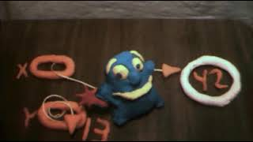
Notes:
https://www.youtube.com/watch?v=3uLKjb973HU

Slide 68
void swap(int a, int b)
{
}
Notes:
A lot of last week's demos involved swapping…
DRINKING GLASS DEMO

Slide 69
void swap(int a, int b)
{
int tmp = a;
a = b;
b = tmp;
}
Notes:
swap0.c
Have this one ready to go in a swap.c file

Slide 70
void swap(int a, int b)
{
int tmp = a;
a = b;
b = tmp;
}

Slide 71
scope

Slide 72
passing by value

Slide 73
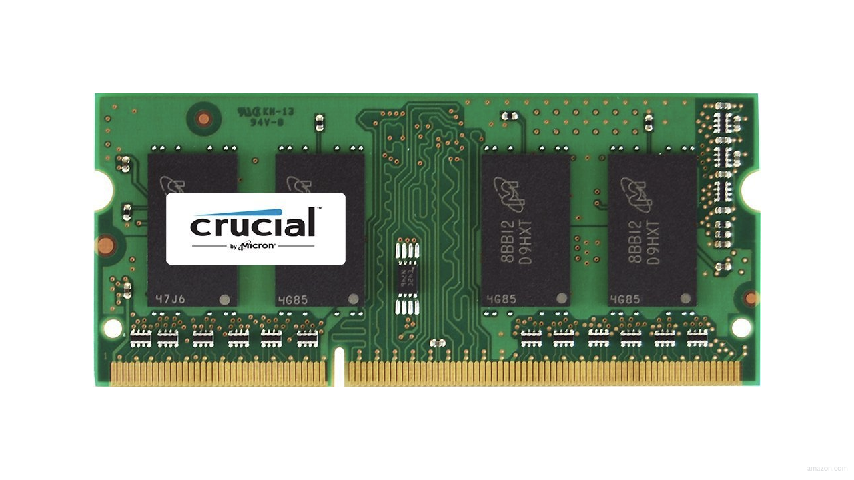

Slide 77
↑
stack

Slide 78
machine code
↑
stack

Slide 79
machine code
globals
heap
↓
↑
stack

Slide 80
machine code
globals
heap
↓
↑
stack

Slide 81
machine code
globals
heap
↓
↑
stack

Slide 82
machine code
globals
heap
↓
↑
stack

Slide 83
machine code
globals
heap
↓
↑
stack

Slide 84
↑
stack
Notes:
show swap0.c again

Slide 85
void swap(int a, int b)
{
int tmp = a;
a = b;
b = tmp;
}

Slide 86
main

Slide 87
swap
main

Slide 88
main

Slide 89
x
y

Slide 90
1
x
2
y

Slide 91
swap
1
x
2
y

Slide 92
a
b
tmp
1
x
2
y

Slide 93
1
a
2
b
tmp
1
x
2
y

Slide 94
int tmp = a;
a = b;
b = tmp;
1
a
2
b
tmp
1
x
2
y

Slide 95
int tmp = a;
a = b;
b = tmp;
1
a
2
b
1
tmp
1
x
2
y

Slide 96
int tmp = a;
a = b;
b = tmp;
2
a
2
b
1
tmp
1
x
2
y

Slide 97
int tmp = a;
a = b;
b = tmp;
2
a
1
b
1
tmp
1
x
2
y

Slide 98
2
a
1
b
1
tmp
1
x
2
y

Slide 99
1
x
2
y

Slide 100
passing by reference
Notes:
so how fix?

Slide 101
void swap(int a, int b)
{
int tmp = a;
a = b;
b = tmp;
}

Slide 102
void swap(int *a, int *b)
{
int tmp = *a;
*a = *b;
*b = tmp;
}

Slide 103
void swap(int *a, int *b)
{
int tmp = *a;
*a = *b;
*b = tmp;
}
Notes:
swap1.c

Slide 104
1
x
2
y

Slide 105
a
b
tmp
1
x
2
y

Slide 106
int tmp = *a;
*a = *b;
*b = tmp;
a
b
tmp
1
x
2
y

Slide 107
int tmp = *a;
*a = *b;
*b = tmp;
a
b
1
tmp
1
x
2
y

Slide 108
int tmp = *a;
*a = *b;
*b = tmp;
a
b
1
tmp
2
x
2
y

Slide 109
int tmp = *a;
*a = *b;
*b = tmp;
a
b
1
tmp
2
x
1
y

Slide 110
a
b
1
tmp
2
x
1
y

Slide 111
2
x
1
y

Slide 112
void swap(int a, int b)
{
int tmp = a;
a = b;
b = tmp;
}

Slide 113
void swap(int *a, int *b)
{
int tmp = *a;
*a = *b;
*b = tmp;
}

Slide 114
machine code
globals
heap
↓
↑
stack

Slide 115
heap
↓
↑
stack
Notes:
What's bad about this picture?

Slide 116
heap overflow
stack overflow

Slide 117
buffer overflow

Slide 118


Slide 119
"Sensors that received the new version of Channel File 291 carrying the problematic content were exposed to a latent out-of-bounds read issue in the Content Interpreter. At the next IPC notification from the operating system, the new IPC Template Instances were evaluated, specifying a comparison against the 21st input value. The Content Interpreter expected only 20 values. Therefore, the attempt to access the 21st value produced an out-of-bounds memory read beyond the end of the input data array and resulted in a system crash."
Notes:
https://www.crowdstrike.com/wp-content/uploads/2024/08/Channel-File-291-Incident-Root-Cause-Analysis-08.06.2024.pdf

Slide 120
"Sensors that received the new version of Channel File 291 carrying the problematic content were exposed to a latent out-of-bounds read issue in the Content Interpreter. At the next IPC notification from the operating system, the new IPC Template Instances were evaluated, specifying a comparison against the 21st input value. The Content Interpreter expected only 20 values. Therefore, the attempt to access the 21st value produced an out-of-bounds memory read beyond the end of the input data array and resulted in a system crash."

Slide 121
get_char
get_double
get_float
get_int
get_long
get_string
...
Notes:
So how about these other training wheels?

Slide 122
get_int
Notes:
get0.c

Slide 123
scanf
…
Notes:
get1.c

Slide 125


Slide 126
 | 50 n

Slide 128
Notes:
get2.c

Slide 129
s

Slide 130
s

Slide 131
s

Slide 133
Notes:
get3.c

Slide 134
s
Notes:
get3.c
get_int allocates just enough memory + 1

Slide 135
file I/O

Slide 136
fopen
fclose
fprintf
fscanf
fread
fwrite
fseek
…
Notes:
phonebook{0,1}.c

Slide 137

Notes:
cp.c
https://stock.adobe.com/search/video?k=progress+bar

Slide 138
BMP

Slide 139


Slide 140
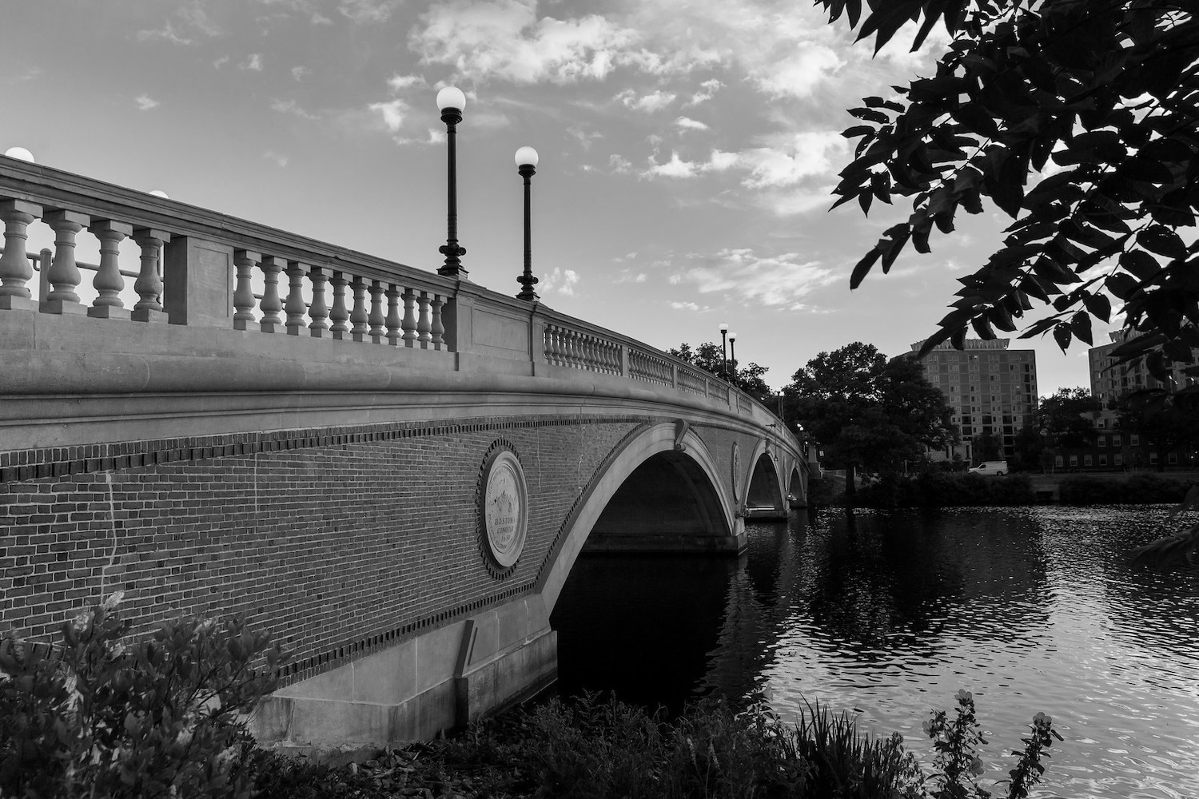
Notes:
grayscale

Slide 141
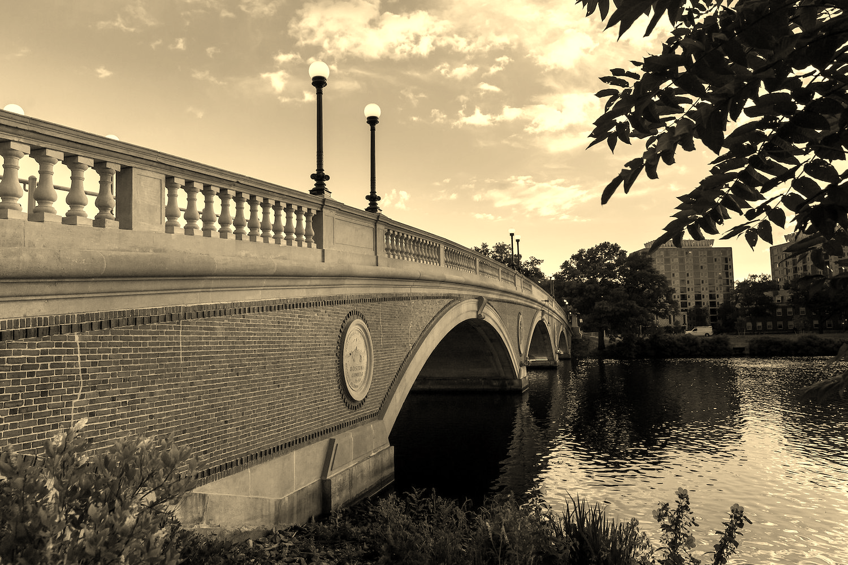
Notes:
sepia

Slide 142

Notes:
reflect

Slide 143

Notes:
blur

Slide 144

Notes:
edge detection

Slide 145
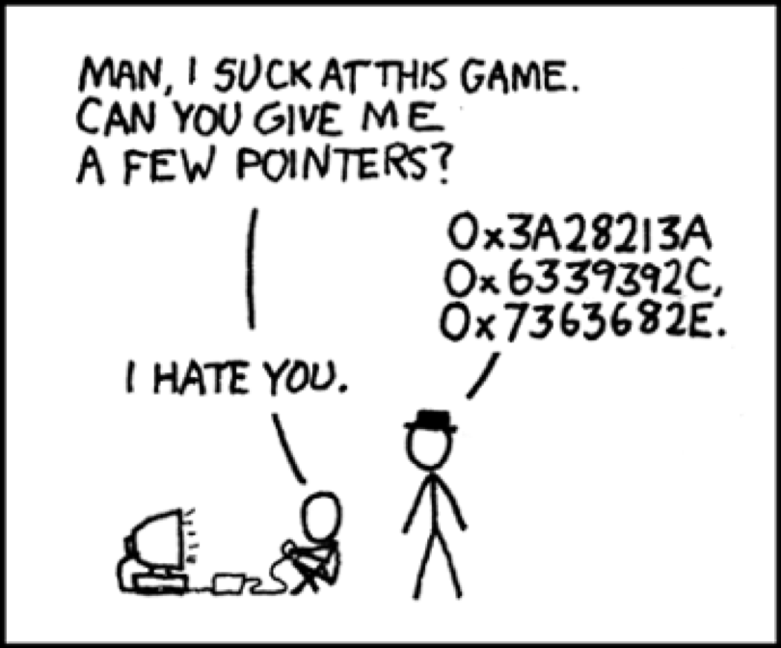
Notes:
https://xkcd.com/138/

Slide 146
